Slide 1
Annual General Meeting 2021 #lovethetrails

Slide 2
Introductions
Board of Directors 2021:
President Deb MacKillop
Treasurer Adam Ekvall
Secretary Nicole Walker
Director Marg Craig
Director Jason Wishlow
Director Megan Chadwick
Director Ben Tanasichuk
The Nelson Cycling Club is a voice for cycling and non-motorized trail use interests in the Nelson area. We are a volunteer non profit society that works to improve and maintain trails and trail access, and hosts fun, recreational events. Our goal is to promote and develop off road cycling opportunities and non-motorized trail use in a socially and environmentally responsible manner for the benefit of Nelson area residents and visitors.

Slide 3
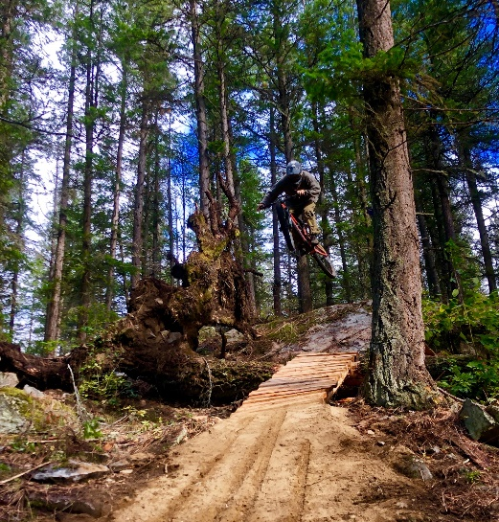
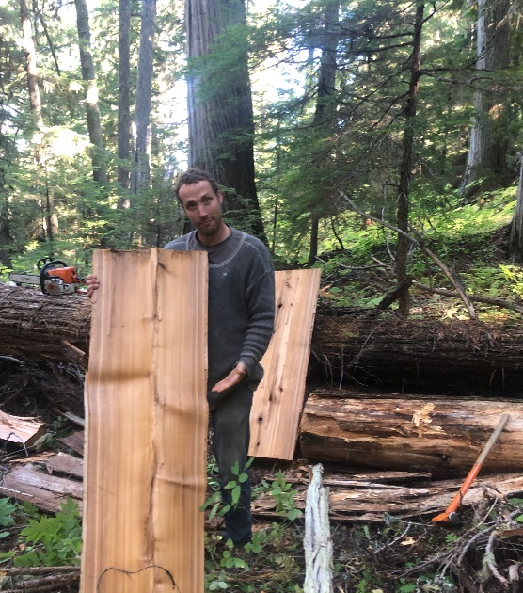
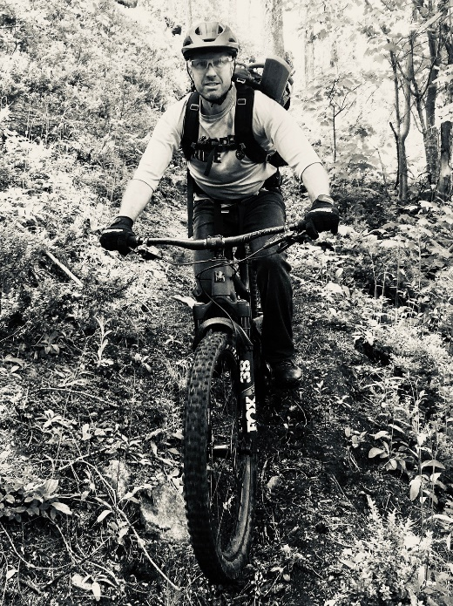
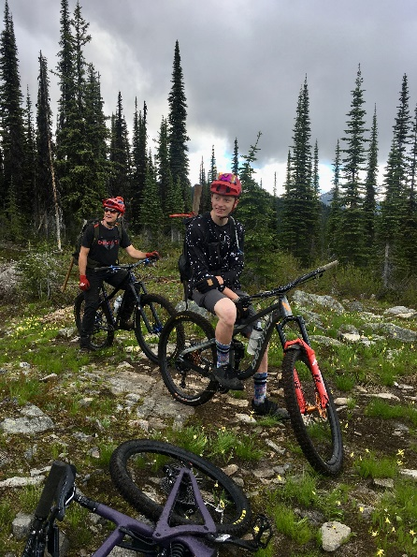
Paid Trail Crew 2021

Slide 4
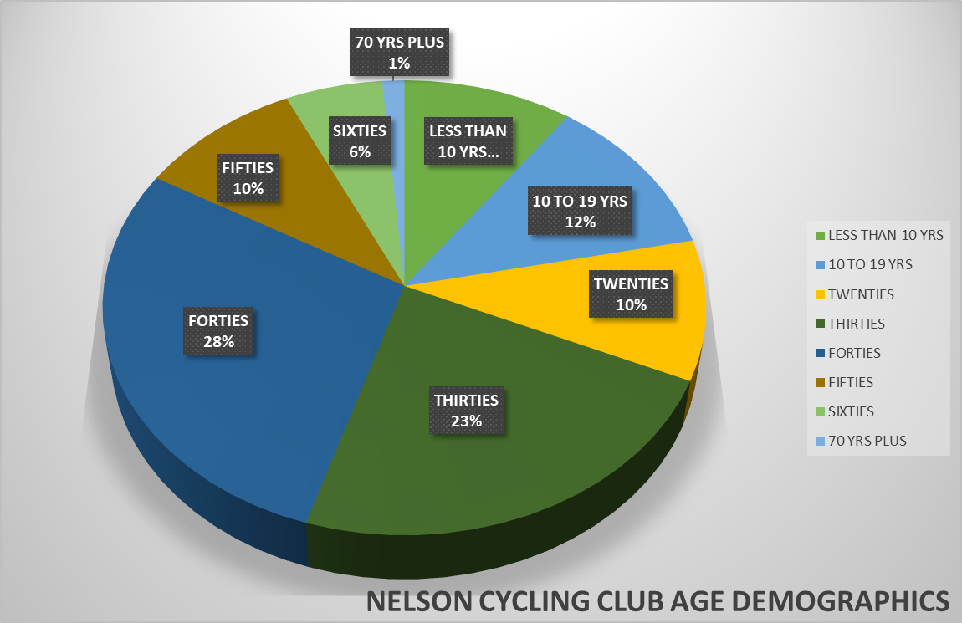
Memberships 2021
260 in 2010
322 in 2011
430 in 2012
315 in 2013
376 in 2014
440 in 2015
445 in 2016
451 in 2017
525 in 2018
540 in 2019
644 in 2020
619 in 2021
**2010-2019 numbers include FTF kids
Less than 10 | 61
10 TO 19 | 72
20 TO 29 | 61
30 TO 39 | 142
40 TO 49 | 175
50 TO 59 | 59
60 plus | 43
Trail Runners | 18
619 members as of November 21

Slide 5
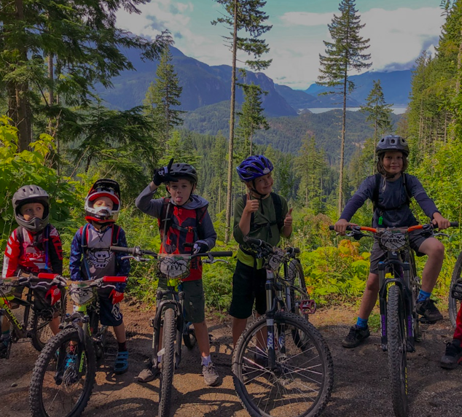
Kids Program
Fall program with ages 8-14
Focus on skill development, trail exploration, and trail stewardship
Safety is biggest priority
Coaches are to be PMBIA trained with current first aide
Next year we are looking to expand and offer both spring and summer camps
Parent volunteers feel free to reach out

Slide 6
Financial Information
Year to date 2021
 | 2021 | 2020
Revenues:
Grants | 23,000 | 274,600
Membership dues | 11,568 | 11,688
Donations | 10,958 | 7,858
Mountain Station advertising | 1,950 | 500
Map sales | 91 | 65
Kids clinic | 660 | -
GST rebate | - | 1,262
Total Revenues | 48,226 | 295,973
 | 2021 | 2020
Expenses:
Trail maintenance/construction | 130,230 | 169,677
Events and volunteer coordination | 666 | -
Insurance | 9,474 | 8,900
Other administration | 4,698 | 8,030
Total Expenses | 145,068 | 186,607

Slide 7
Cash balance
 | Nov 23 2021 | Dec 31 2020
Cycling club cash | $ 29,448 | $ 30,895
Grant cash | $ 20,411 | $ 126,618
Total | $ 49,859 | $ 157,513
Additional grant cash of approximately $72k expected to be received this winter

Slide 8
The Board Nominations
Director position nominations for 2021:
Megan Chadwick
Marg Craig
Adam Ekvall - Treasurer
Deb MacKillop - President
Ben Tanasichuk
Nicole Walker – Secretary
Jason Wishlow

Slide 9
New Business: more IDEAS for the future
Member surveys
Where do you ride most?
What needs most work?
More trail stewardship
Giveout grizzlies
Logging plans
Grohman Trails (mini storage)
Kids programs
Expansion of the pilot program
Trail Plans for 2021
Complete Rhythm and Blues (Born Again)
Complete Blue Steele (Giveout to Morning Mountain
Connect from Cottonwood Lake to Silverking
Another trail at Selous
Trails on Giveout Face (to Rosemont)?
Other ideas?

Slide 10
Many Thanks!
RDCK: Ramona Faust and Tom Newell, Directors Area E and F
RDCK Parks Department
Kootenay Lake Initial Attack Crew
Recreation, Sites and Trails BC
Valhalla Pure Nelson
Inland Allcare
The trail fairies out there helping out:
DH Beer League
Daily Danks
Doug Turner
MAMWBABs
And many more!

Slide 11
